Slide 2
IPCRG Research prioritisation: where are we now?
Siân Williams
Neil Fitch

Slide 3
International Primary Care Respiratory Group (www.ipcrg.org)
Our vision is of a global population breathing and feeling well through universal access to right care
Our mission is to work locally in primary care and collaborate globally to improve respiratory health

Slide 4
IPCRG Research prioritisation Small grant awards supporting our priorities

Slide 5
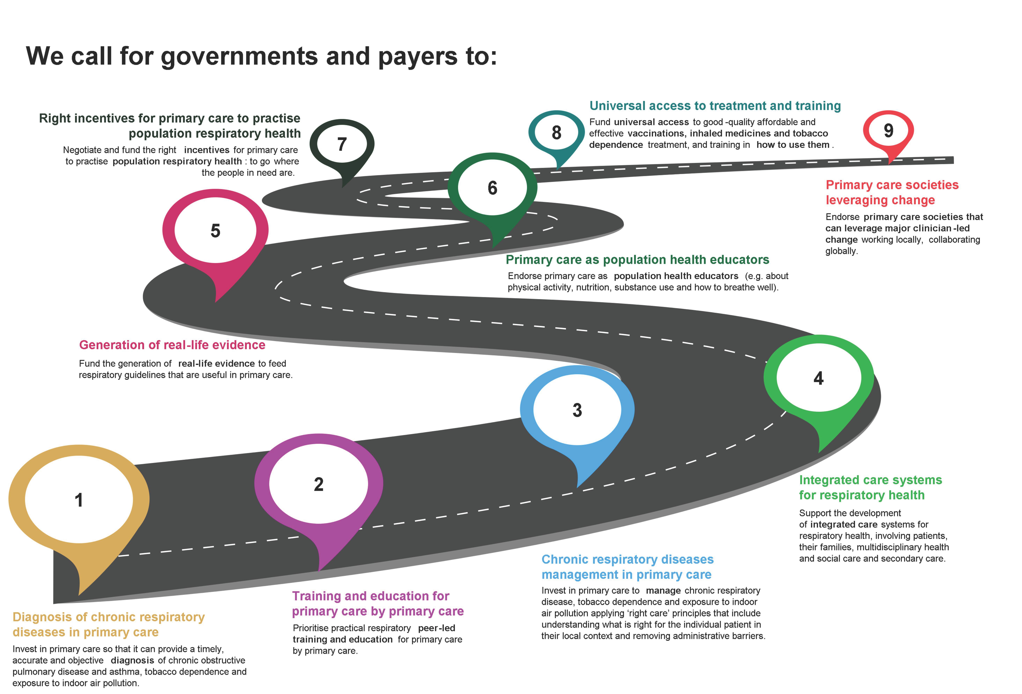
CRD roadmap agreed between IPCRG and WONCA Europe
Williams S et al npj Prim. Care Respir. Med. 34, 4 (2024)

Slide 6
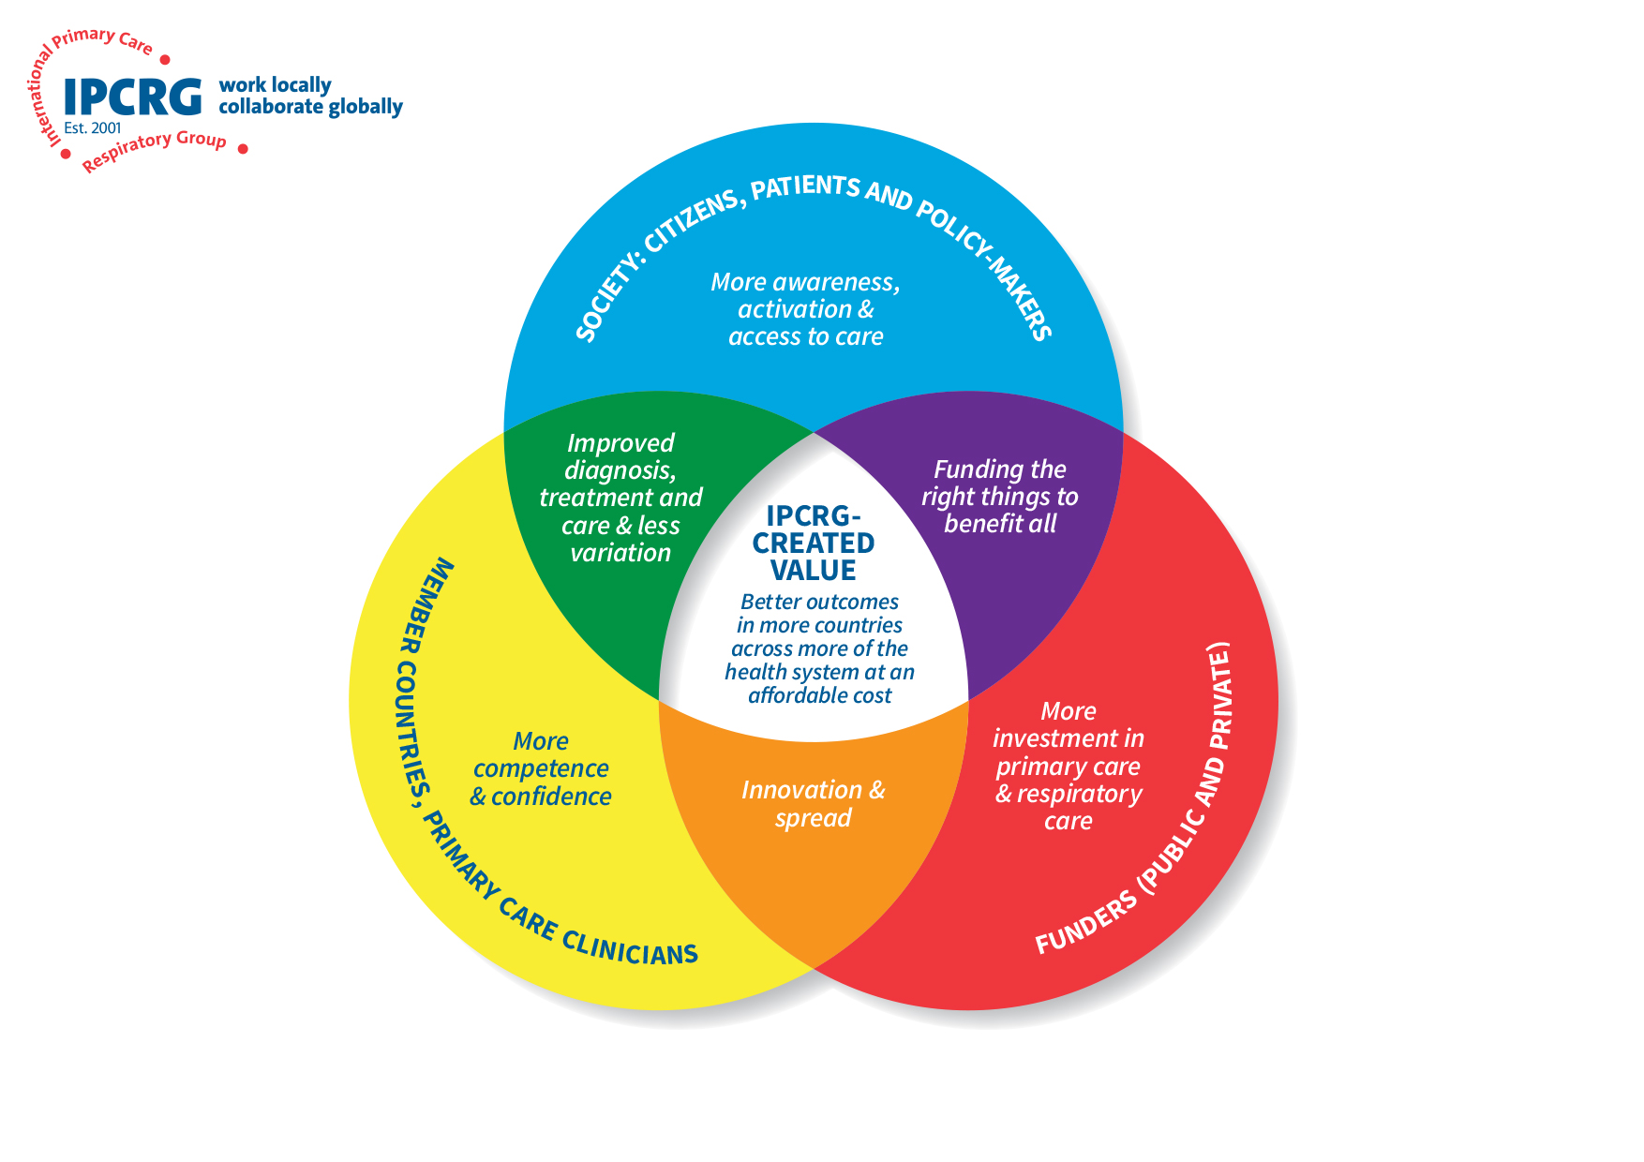
Multidisciplinary team-building workshop
Digital magazine issue 2 on COPD self-management (mood, mental health, energy, nutrition, sleep) incorporating patient video diaries
Leadership of stakeholder engagement in three global health programmes in 15 LMICs including launch of Breathe Well South America
Desktop Helper No.18 - Usefulness of Peak Expiratory Flow (PEF) in Everyday Clinical Practice for Asthma
Desktop helper and workshops on Breathlessness in adults: A practical guide for primary care clinicians
Publications and teaching on stakeholder engagement
Contributions to WHO Knowledge Portal
Free e-learning course Primary Care Education on COVID-19 and Respiratory Disease
Small grants programme (10 grants) in support of research prioritisation
Launch of Spirometry Simplified: certified e-learning, masterclass and mentoring package for primary care
Coordination of Global Health Respiratory Network including a journal club for early career researchers
Growth of our social movement Asthma Right Care: more countries, more parts of the health system
Growth of our social movement COPD Right Care by finalising COPD Wheel & Question & Challenge cards
Leadership schools for multi-disciplinary teams and also RESPIRE researchers
Advocacy school for RESPIRE researchers
Initiation of social movement for Rhinitis Right Care
Social media campaign course for FRESHAIR4Life researchers
Teach the Teacher programmes in support of implementation of FRESHAIR4Life in 5 countries to reduce adolescent exposure to risk
High value opportunities at our conference and WONCA and FIP meetings to build partnerships and to showcase the value of primary care and its multi-disciplinary workforce
Teach the Teacher programmes in Latin America, Asia, North Macedonia for asthma & COPD
Delivered capacity building programmes for Horizon and UKRI-funded FRESHAIR4Life programme to reduce adolescent exposure to air pollution and tobacco in 5 countries
Adaptation/localisation of materials into multiple languages
Dissemination of research from Breathe Well, RESPIRE
12th World Conference, Athens with a focus on planetary health
2024

Slide 7
Why determine respiratory primary care research priorities?
To understand which research questions concern most primary care healthcare professionals
To better address an often undervalued disease area, with a focus on improving practice
To reduce the 7.7million deaths per year that respiratory conditions account for
To improve clinical guidelines and patient care globally.
Update 2012 prioritisation exercise Prim Care Respir J. 2012 Mar;21(1):19-27. doi: 10.4104/pcrj.2012.00006.

Slide 8
Geographical coverage
608 questions
from 112 community-based physicians, nurses and other healthcare professionals
representing 27 high, middle and low-income countries
27 academic experts reduced these to 176 questions using an e-Delphi process
Map courtesy of www.mapchart.net

Slide 9
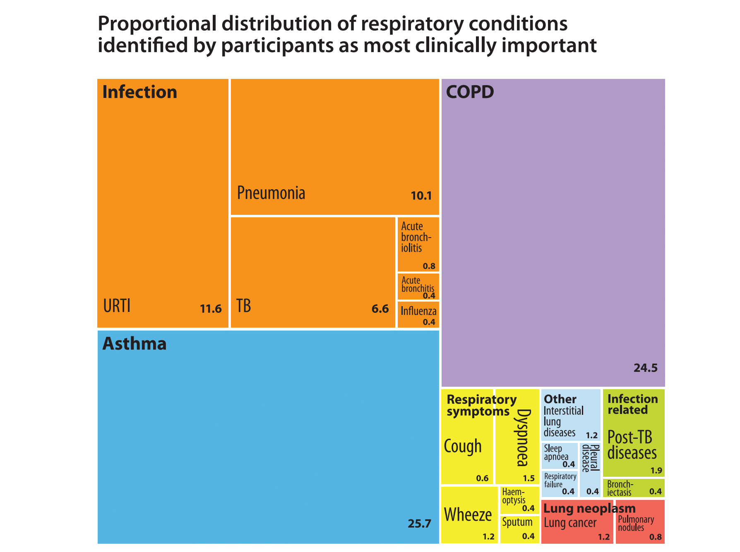
Asthma and COPD were the most frequently mentioned diseases and the diseases of most concern
Infectious respiratory diseases taken together (TB, pneumonia) were mentioned most and were also of highest concern
URTI: upper respiratory tract infection
TB: tuberculosis COPD: chronic obstructive pulmonary disease

Slide 10
Final research questions by topic (%)
The most frequent questions were related to COPD management and asthma self-management

Slide 12
49 questions reached 80% consensus for importance after e-Delphi rating stages Top 10 ranked questions
Question | Consensus
What is the best way to manage chronic/ persistent cough in primary care? | 100%
What are the best ways to monitor asthma in primary care? | 100%
What steps could be taken to prevent exacerbations and progression of asthma? | 97.1%
How can brief advice be better used to increase motivation to quit tobacco use, and what elements are most efficient for a busy primary care practitioner? | 97.1%
How should we best manage COPD in patients with cardiovascular diseases, arrhythmias and uncontrolled hypertension? | 97%
What are the most effective strategies for ensuring sustained good inhaler techniques among asthma patients? | 94.2%
What methods could be used to enhance the use of asthma controller therapy? | 94.1%
How could we improve COPD 'patients’ use of inhalers? What are the best ways to teach people and how can we apply them in daily clinical practice? | 94.1%
What is the best way to engage people with asthma in self-management? | 94.1%
How can we best educate healthcare professionals to improve early recognition and diagnosis of COPD? | 94.1%

Slide 13
IPCRG Small grant awards - Status
The award programme supported small research projects that help answer the top 10 research questions from the IPCRG’s Research prioritisation exercise.
From a recognised research organisation in any country
To help Early Career Researchers in carrying out high quality work to develop their expertise.
11 awards over two rounds totalling £50,000
Projects started in 2023/4
7 studies completed
Results disseminated with journal publication , oral presentations, posters, workshops, local newspaper articles
4 studies ongoing, 1 with data being collected, others with write up continuing

Slide 14
IPCRG Small grant awards: Award topics
4 on Cough – including diagnosis, management, monitoring and with Obstructive Sleep Apnoea
3 on COPD including self management, screening and adherence
2 on inhaled medicines and technique
3 on asthma, including telehealth with children, asthma care and monitoring tools

Slide 15
IPCRG Small grant awards and investigators
How people living with COPD with co-morbid conditions self-manage themselves at home, focusing on the integration of pulmonary rehabilitation exercises. | Hani Syahida Salim | Malaysia
Understanding how to best address the care gap resulting from the underuse of inhaled medicines in respiratory conditions | Shamanthi Jayasooriya | UK
Priorities, and barriers in asthma care in the PHC systems of Slovenia, Croatia, Bosnia and Herzegovina, Serbia, Montenegro, and North Macedonia. | Žan Trontelj | Slovenia
Summarise useful theories and models for the development of an optimal method for inhaler technique education | Lars Dijk | Netherlands
What is the best way to manage persistent cough in primary care in low resource settings such as Uganda | Edwinah Atusingwize | Uganda
Attitudes and perspectives on screening for COPD in China | Zihan Pan | China
Development and feasibility evaluation of a decision support tool to diagnose and manage chronic cough at primary health clinics. | Wen Ming Koh | Malaysia
Role of telehealth strategies in children with asthma in primary health care, a scoping review | Mauricio Soto | Chile
Analysis of chronic cough among patients with Obstructive Sleep Apnoea Syndrome in the Kyrgyz Republic | Lorenzo Cirri | Switzerland/Kyrgyz Republic
Applying the Test of Adherence Toolkit to patients with COPD in Kyrgyzstan | Aizhamal Tabyshova | Netherlands/Kyrgyz Republic
Identifying monitoring tools from the GPs and patient perspective for uncontrolled symptoms of asthma, chronic cough or breathlessness. | Alice Crawford/John Blakey | Australia

Slide 16
IPCRG Small grant awards: Achievements
1. A photo-elicitation study: Self management at home - Exercise & COPD, Malaysia: Hani Syahida Salim
Enhanced awareness of home-based exercise challenges among rehabilitation attendees & providers.
Healthcare professionals informed for better COPD care.
Community engagement for broader dissemination (in progress).
2. Beliefs surrounding the use of inhaled asthma medication in The Gambia: a qualitative study of asthma patients and health care workers (Published: npj Primary Care Respiratory Medicine, Jayasooriya et al. 34: 29, 2024) Shamanthi Jayasooriya
Limited access to inhalers was an issue resulting in continued use of oral medications.
Some people living with asthma recognised the benefits of inhalers, yet beliefs that inhalers were dangerous were common.
Reliance on oral short-acting beta agonists meant asthma was seen as a recurrent acute condition resulting in an emphasis on hospital management and little awareness of inhaled preventative medicines.
Conclusion: Increasing access to inhaled medicines, has the potential to reduce costly avoidable admissions, but socio-cultural factors, in addition to medication supply, need addressing.

Slide 17
IPCRG Small grant awards: Achievements
3. Stakeholder perspectives and experiences of persistent cough management in Wakiso District, Uganda Edwinah Atusingwize
Persistent cough was perceived as normal and increasing with community members practicing self-medication
Patient empowerment and a multidisciplinary approach to persistent cough was lacking
Knowledge gaps (health workers and community) and economic constraints (community level) limited persistent cough management within primary care.
4. A feasibility study to evaluate a decision support tool to diagnose and manage chronic cough at primary health clinics (CC-DST), Malaysia Wen Ming Koh
After feedback from IPGRG conference, the tool shifted from a paper to a user-friendly web application and now collects patient data and generates a list of likely diagnoses and its supportive features
User Testing with primary care doctors to assess user experience and functionality ongoing and feasibility study underway to understand the tool's potential impact on improving diagnosis, referral times, and treatment outcomes for chronic cough.

Slide 18
IPCRG Small grant awards: Achievements
5. Applying the TAI (Test of Adherence to Inhalers) Toolkit to patients with COPD in Kyrgyzstan Aizhamal Tabyshova
91% of doctors satisfied with TAI Toolkit
Translated to local language and adapted to local setting the TAI Toolkit
Implementation is continuing
6. Exploring stakeholders' attitudes and perspectives on COPD screening in China - A qualitative study Zihan Pan
The study helped us understand how COPD screening was implemented in China
This project provided an important preliminary research basis for our future study
Nb COPD has been included in national public health services, a major change for respiratory health care in China
7. Association between sleep apnoea and chronic cough in the Kyrgyz Republic
Shown a higher prevalence of chronic cough in untreated OSA patients (16.4%) vs treated with CPAP (10%)
Strengthened the case for early diagnosis and CPAP treatment in OSA patients to reduce CC
Provided evidence to support integrating OSA screening in patients presenting with CC
Created a foundation for future research and policy development to improve OSA/CC services in the KR

Slide 19
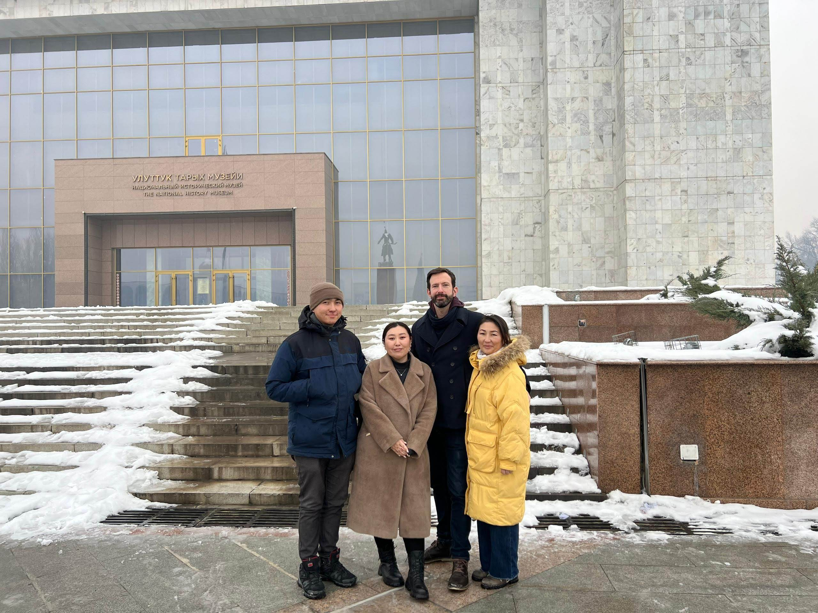
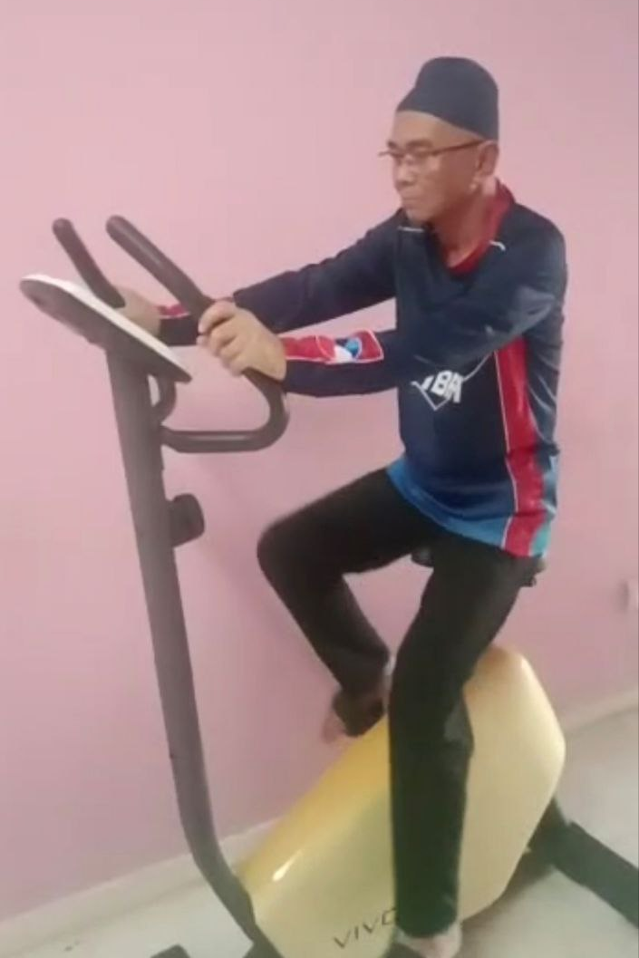
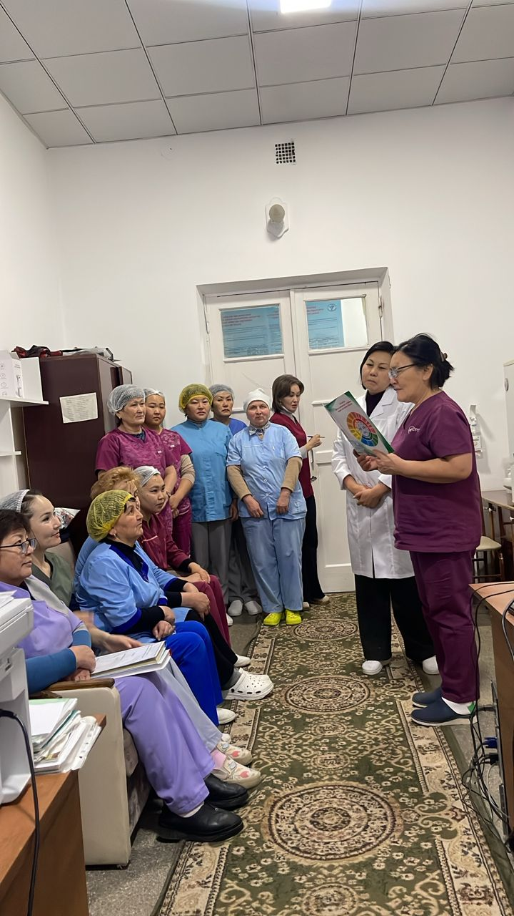
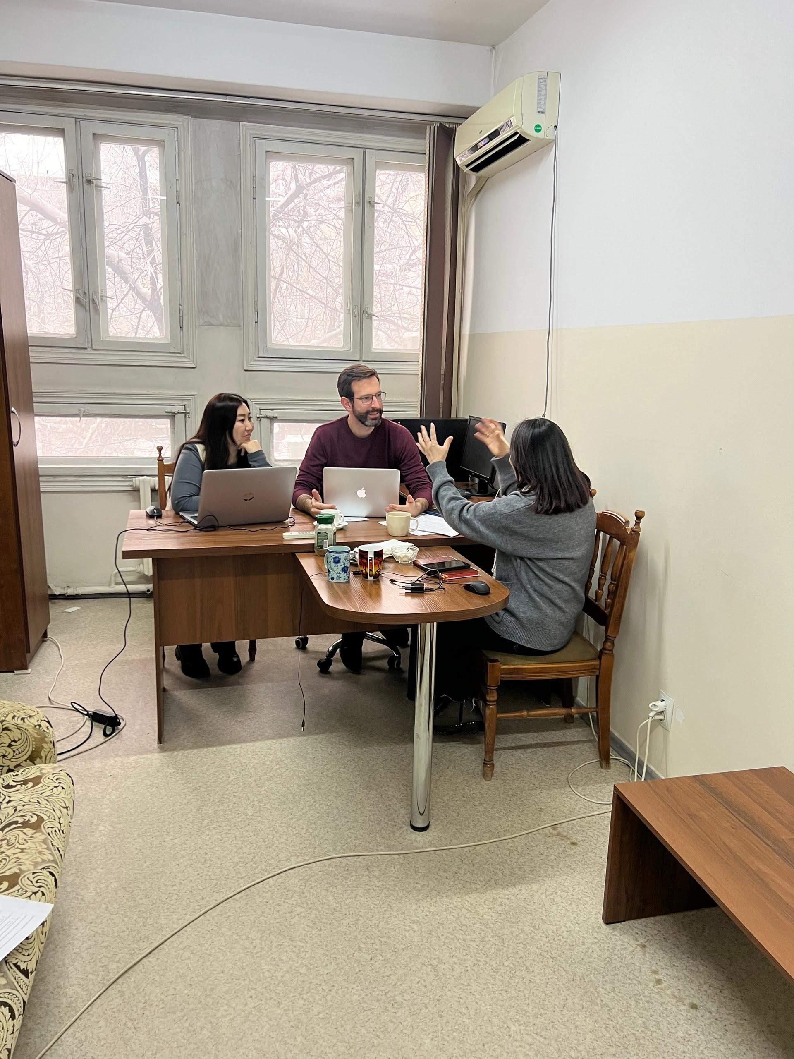
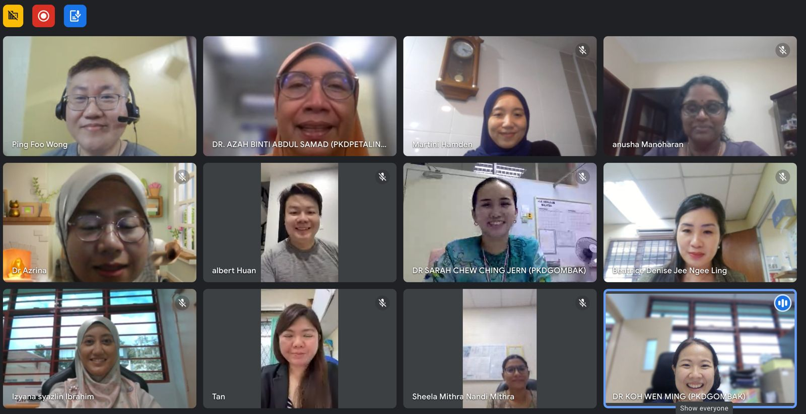
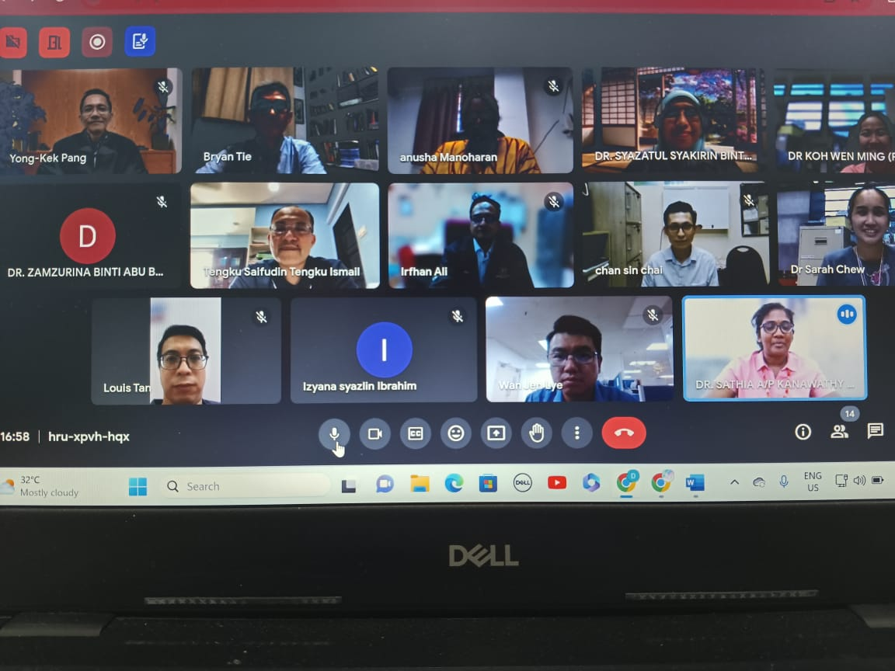
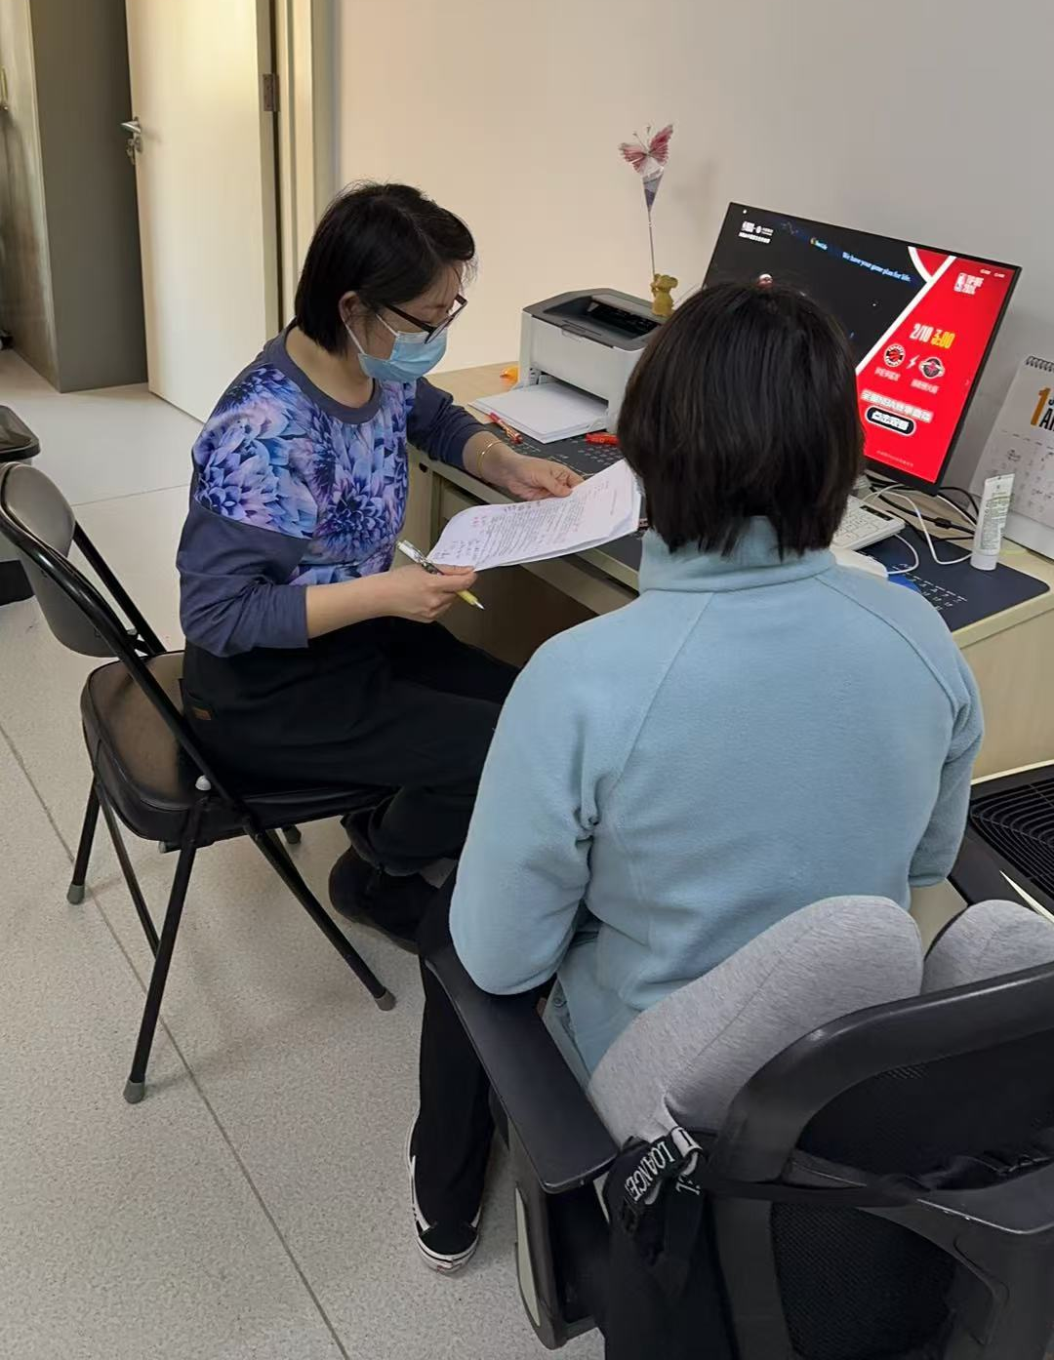
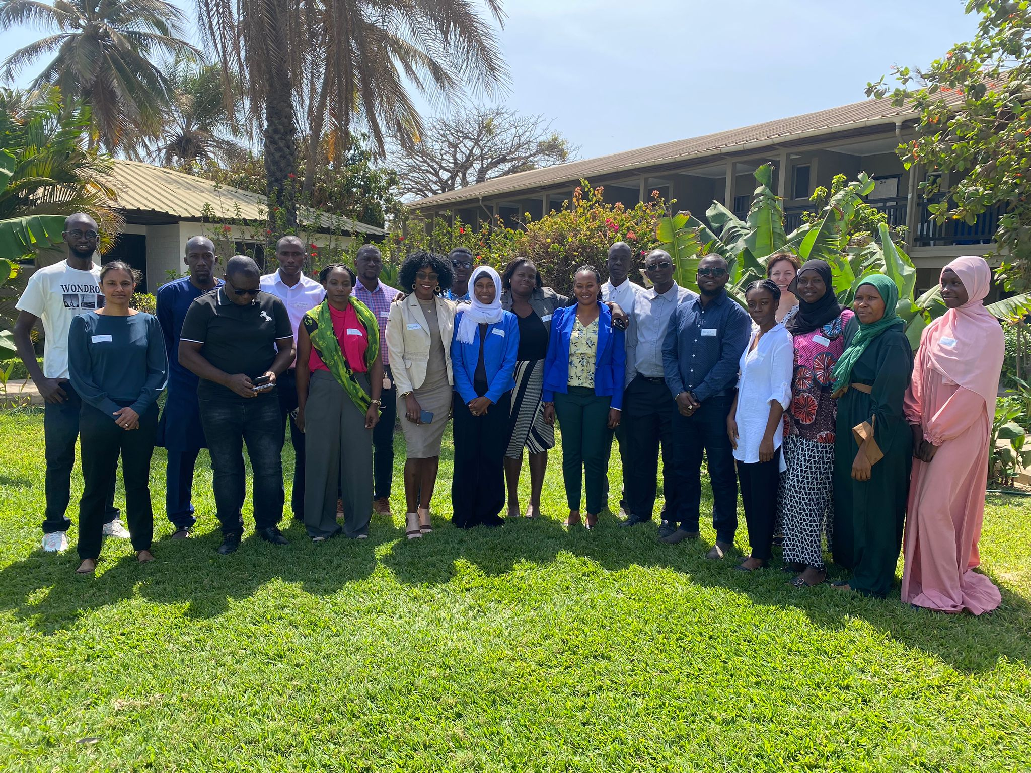
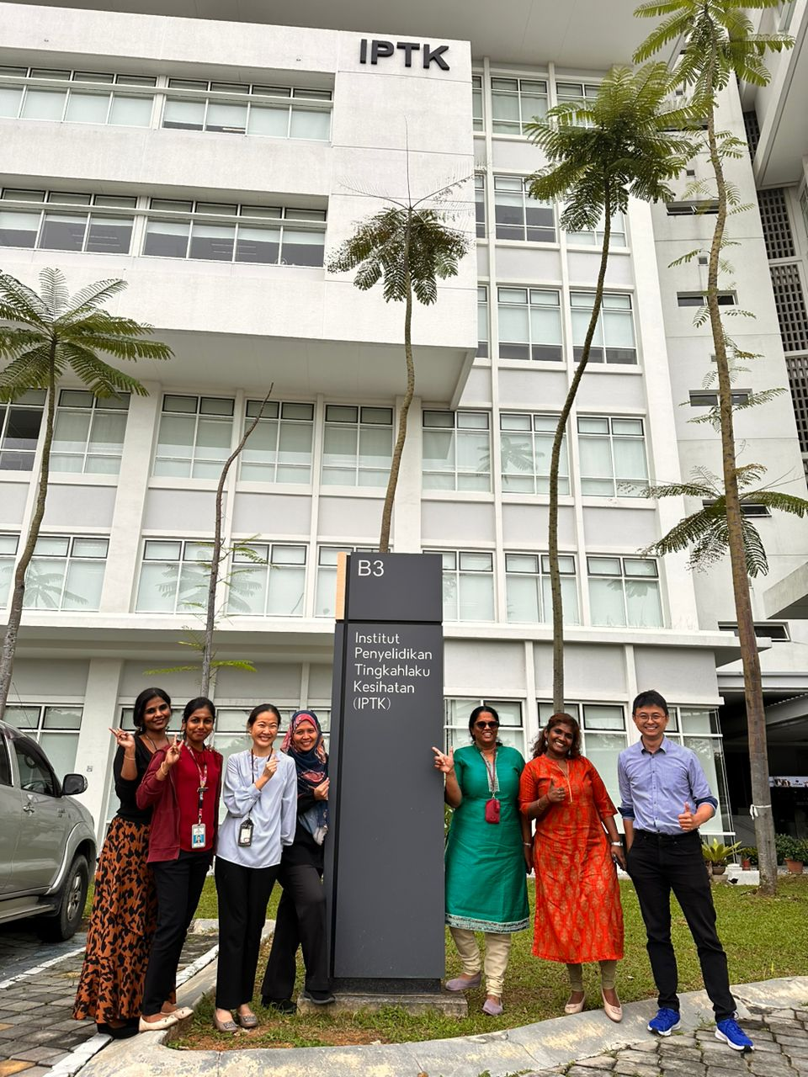
Primary care Physicians
Respiratory Physicians

Slide 20
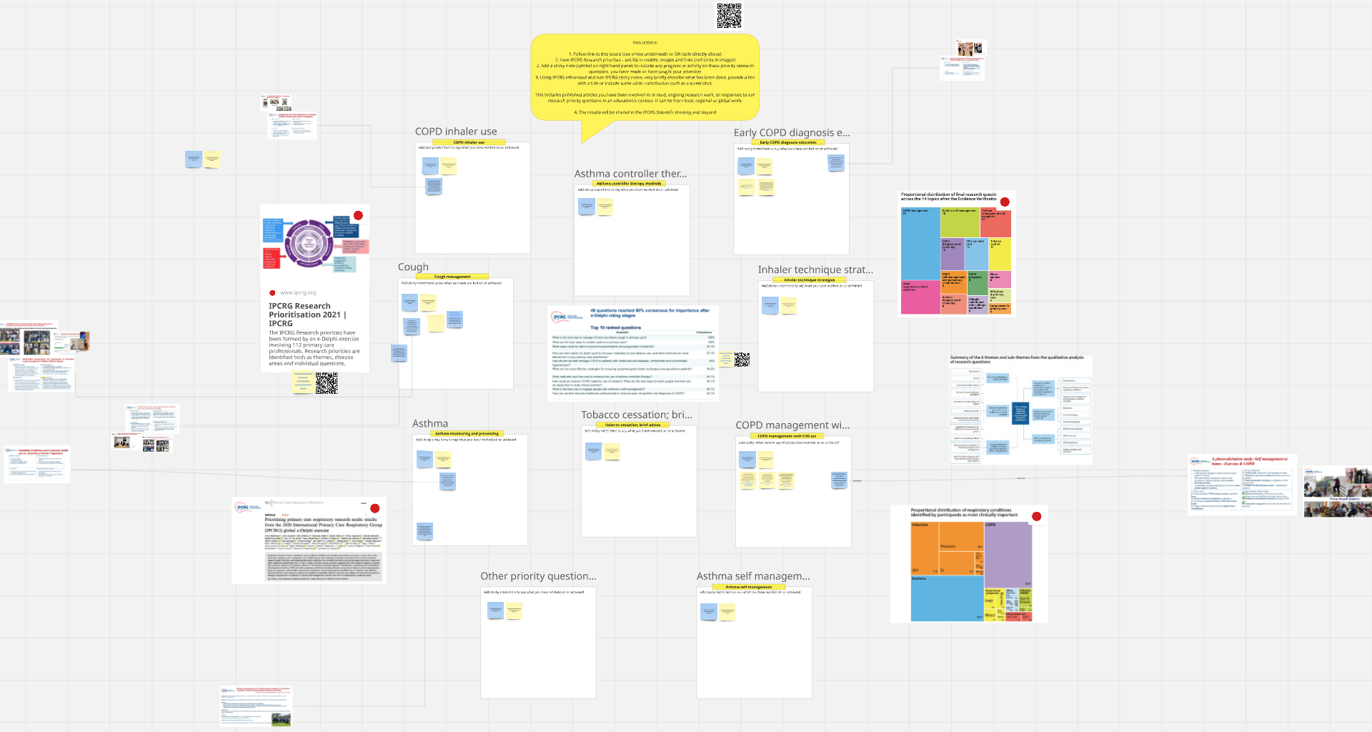

Slide 21
Number 1. Research priority: Cough
No.
papers
Year
Reflects all Chronic cough papers (next slide)
2025 ahead of 2024

Slide 22
Number 1. Research priority: Cough
No.
papers
Year

Slide 23
6 papers on chronic cough primary care since 2020 in npjPCRM
PubMed Search query: Chronic cough primary care
14 papers on cough primary care since 2020 in npjPCRM

Slide 24
PubMed: Comparison Asthma and COPD papers in primary care
No.
papers
Year
No.
papers
Year

Slide 25
Reflecting priorities in our work
Project dependent
Country dependent
Usually related to the work in the paper
Also pollution, COVID
Search GHRN (Major Funded projects – NIHR in UK and EU Fresh Air projects)

Slide 26
What next?
Include significant papers, projects or work in the Miro Board
Continue the analysis of the impact of IPCRG Research priorities
Launch global collaborative on implementation studies in primary care convened by WHO bringing together research funders, researchers and knowledge users
Other ideas?

Slide 27
Thank you

